Slide 1
SPI-RRT Data Analysis
Data Analysis Examples

Slide 2
Content Overview
Data Management
Country Case studies

Slide 3
Data Use: Key Steps
Quality check (multi-level)
Using data for impact
Using data to monitor progress

Slide 4
Data completion = critical component of quality
Having complete data set important for analysis and impact
Scores for each question in each section (1-8) of the checklist (No N/A)
Comments for areas where deficiencies were identified (“Partial” or “No”)
Incomplete data can lead to bias
Are there any gaps? Why?
Need additional training of auditors?
Review of the national guidelines, study protocol and SPI-RRT user guide
Making process more efficient and complete
Notes:
Animate >
Newly diagnosed # missing
% of newly diagnosed tested missing
Animate >
Missing VL > Why?

Slide 5
Data Management

Slide 6
Excel Template for Paper-based Forms
1. All Site Audits tab
Site Information
Serial No. - Serial number is a unique number assigned to each audited site.
Facility Name - Enter the name of the site.
Affiliation - Select one of the choices (government, private, faith-based organization, non-governmental organization, or other) in the drop down box.
Specify if other - If "other" is chosen for the affiliation, then specify the affiliation.
Facility ID - (If applicable) Enter the unique facility identification number.
Type of testing modality - Enter the type of testing site (e.g. VCT, HTC, PMTCT, HTC/VTC/ART, PITC, etc.)
Site District - Enter the district where the site is located.
Site Region - Enter the region where the site is located.
Number of Testers - Enter the number of testers that perform HIV-RT at the facility.
Average number of tests/month - Enter the average number of HIV-RT tests performed per month.
Audit Information
Date of Audit - Enter the date that the audit was completed.
Audit Number - Enter the number of the audit (i.e. that describes how many audits have occurred at the site).
Name of Auditor - Enter the name of the auditor that performed the audit.
Audit
For each question within each QSE* section, indicate whether the Facility is compliant by entering 1 if yes, 0.5 if partially compliant, and 0 if no.
*QSE (Quality System Essentials)
QSE 1 | Personnel Training and Certification
QSE 2 | Physical facility
QSE 3 | Safety
QSE 4 | Pre-Testing
QSE 5 | Testing
QSE 6 | Documents and Records
QSE 7 | EQA
QSE 8 | HIV-1 Recent Infection Surveillance
Audit Calculations
SPI-RT Total Points - This number is calculated as performance points (i.e. yes=1, partial=0.5, no=0) are entered for each QSE question. The formula for adding all points is already pre-entered.
SPI-RT ExpectedTotal Points - This is the maximum total points a site may accrue.
SPI-RT Score (%) - This is the performance score and is calculated as points are entered for each QSE question. The formula, (total points accrued/total possible points)*100, is already pre-entered.
SPI-RT Level - This is the performance level corresponding to the calculated performance score and is calculated as points are entered for each QSE question. The formula is already pre-entered, based on SPI-RT scoring criteria: <40=level 0; 40-59=level 1; 60-79=level 2; 80-89=level 3; >90=Level 4
QSE Total - The number of points accrued within a particular QSE (i.e. QSE 1-7). It is calculated as points are entered for each question within the QSE section. The formula is already pre-entered.
Section Total expected - This number is the maximum total points a site may accrue within a particular QSE section, which depends on the number of questions in the section.
QSE Score (%) - This is the performance score for a particular QSE and is calculated as points are entered for each question within the QSE section. The formula is already pre-entered.

Slide 7
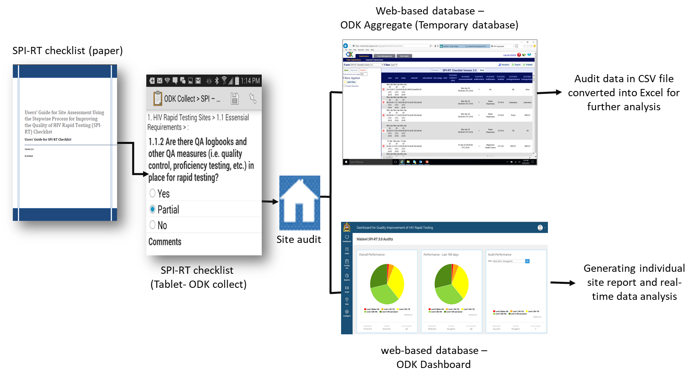
SPI-RT Audit Tools

Slide 8
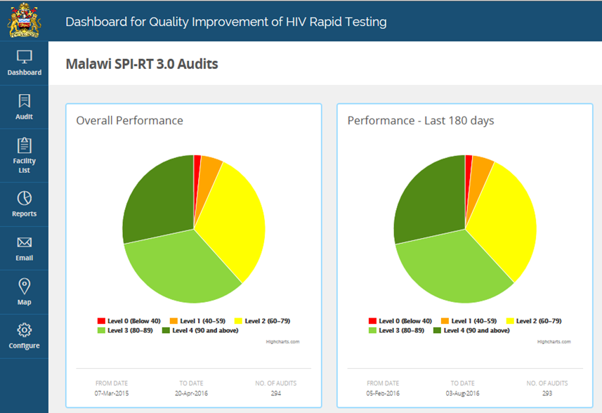
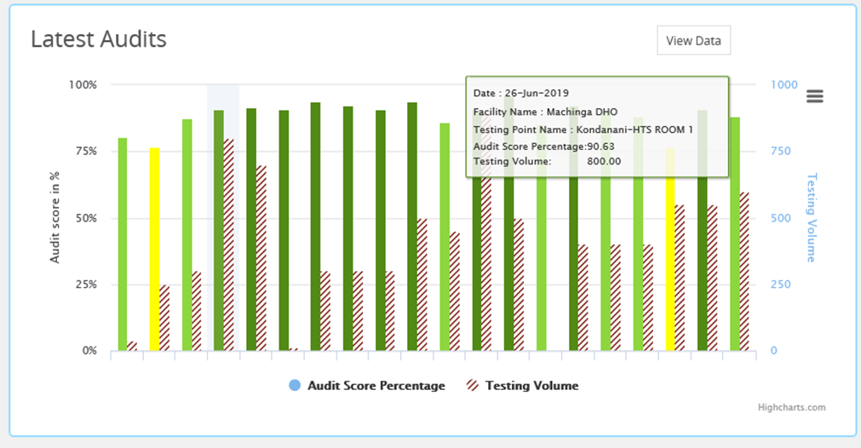
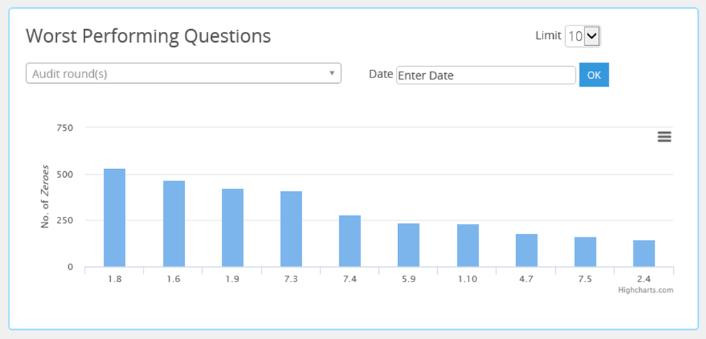
Real-time Access to SPI-RT Site Audits Data

Slide 9
Country Case Studies
Monitoring Impact

Slide 10
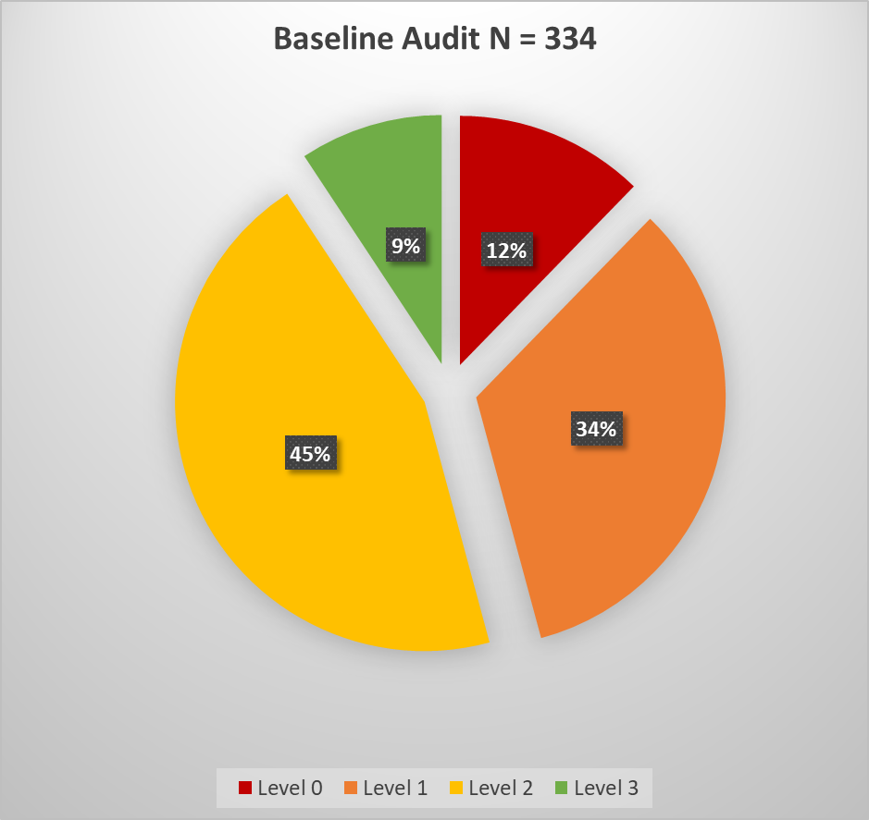
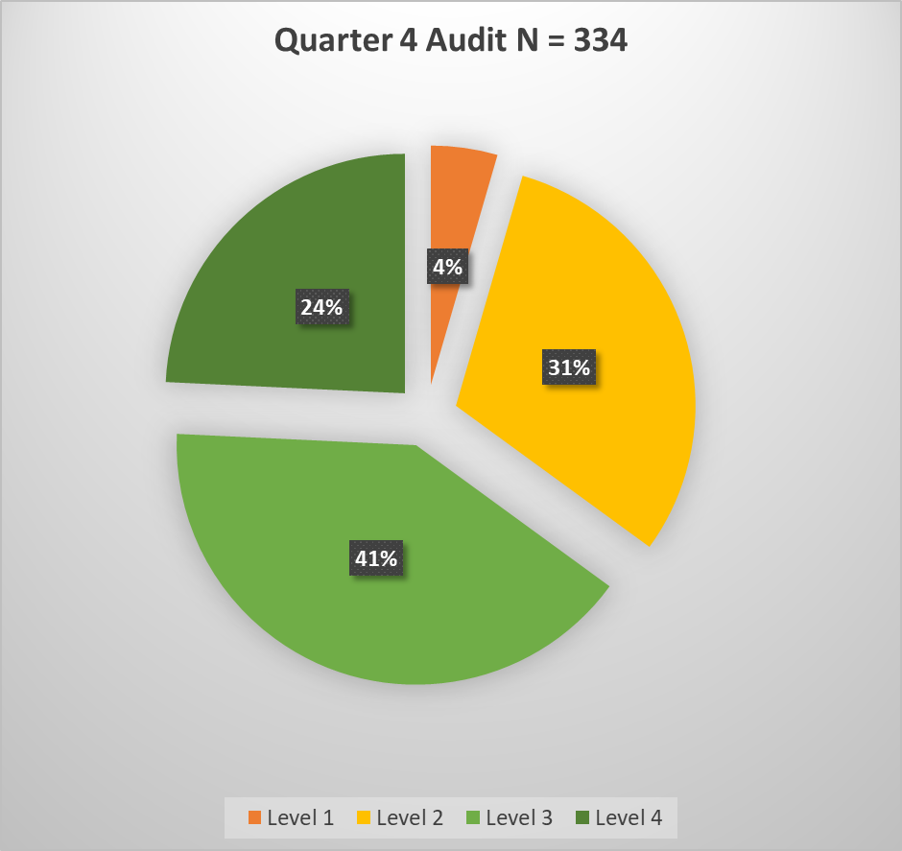
SPI-RT Audit Data - Baseline to Q4 Audits (N = 334) Country X

Slide 11
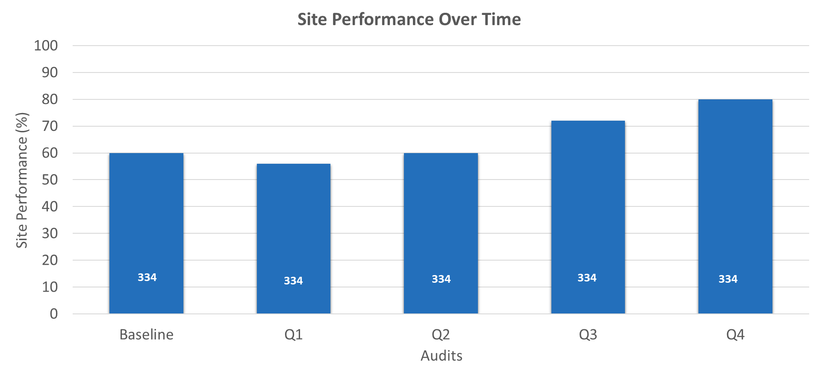
Monitoring Impact – Country X

Slide 12
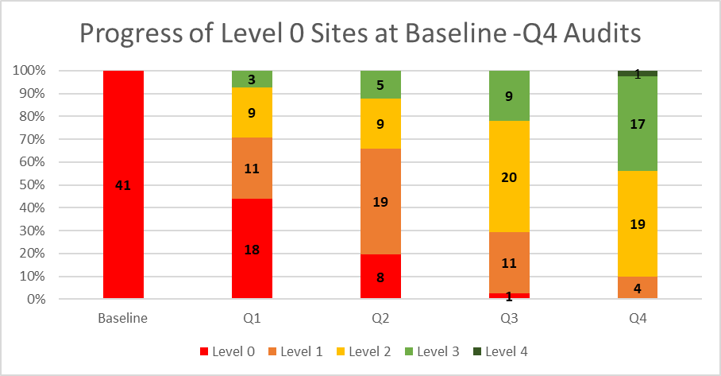
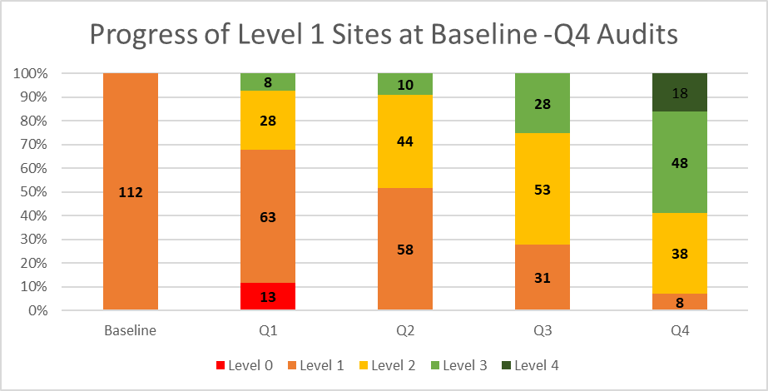
Progress of Sites from Baseline to Q4 Audits - Country X
Notes:
Shift due to bias possible bias during baseline audit. It was performed by someone who was an IP familiar with the site and has close relationship with the staff. They oversee the QA activities for the site and the outcome may reflect poorly on their overall performance. That’s why the user guide was developed to assess a site against a set of QA standards and eliminate any bias.

Slide 13
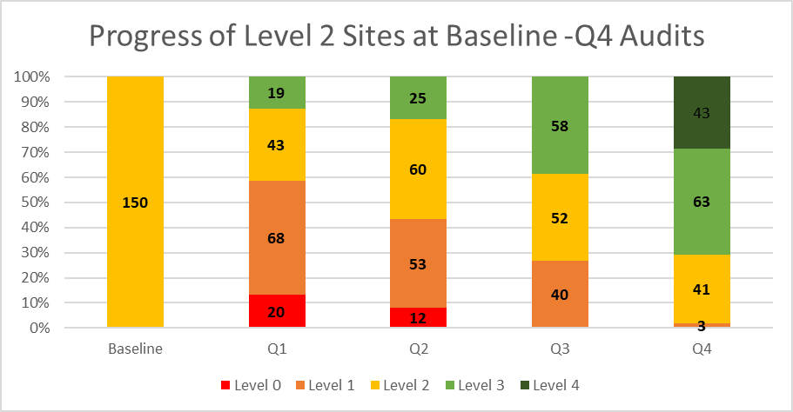
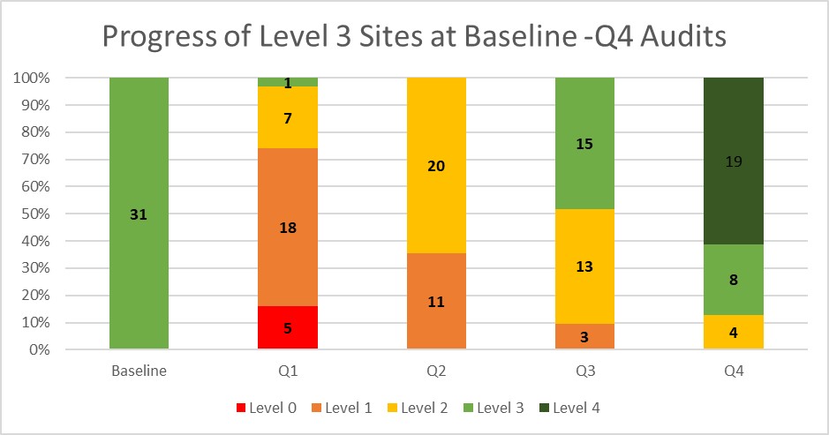
Progress of Sites from Baseline to Q4 Audits – Country X

Slide 14
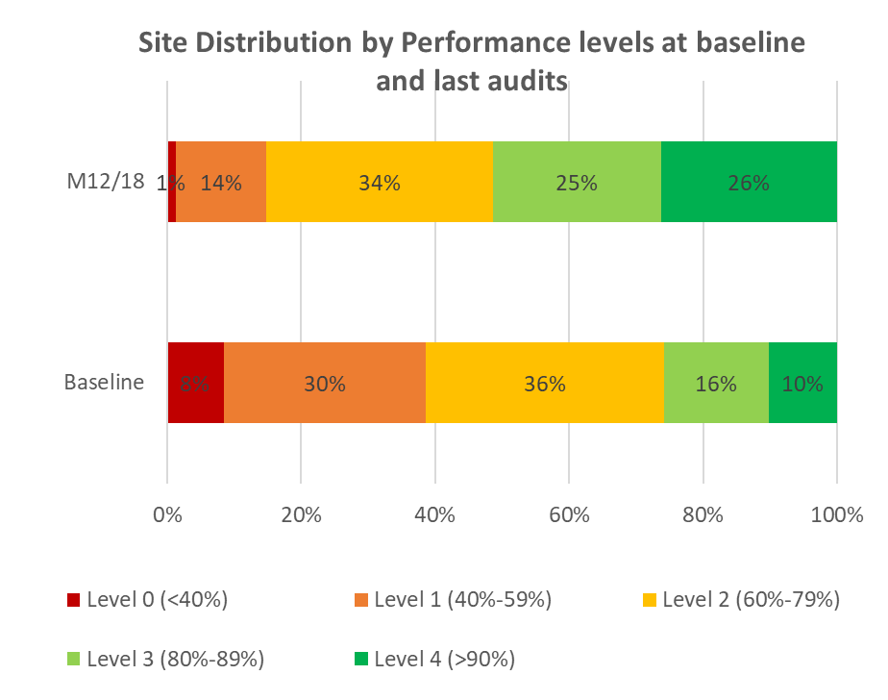
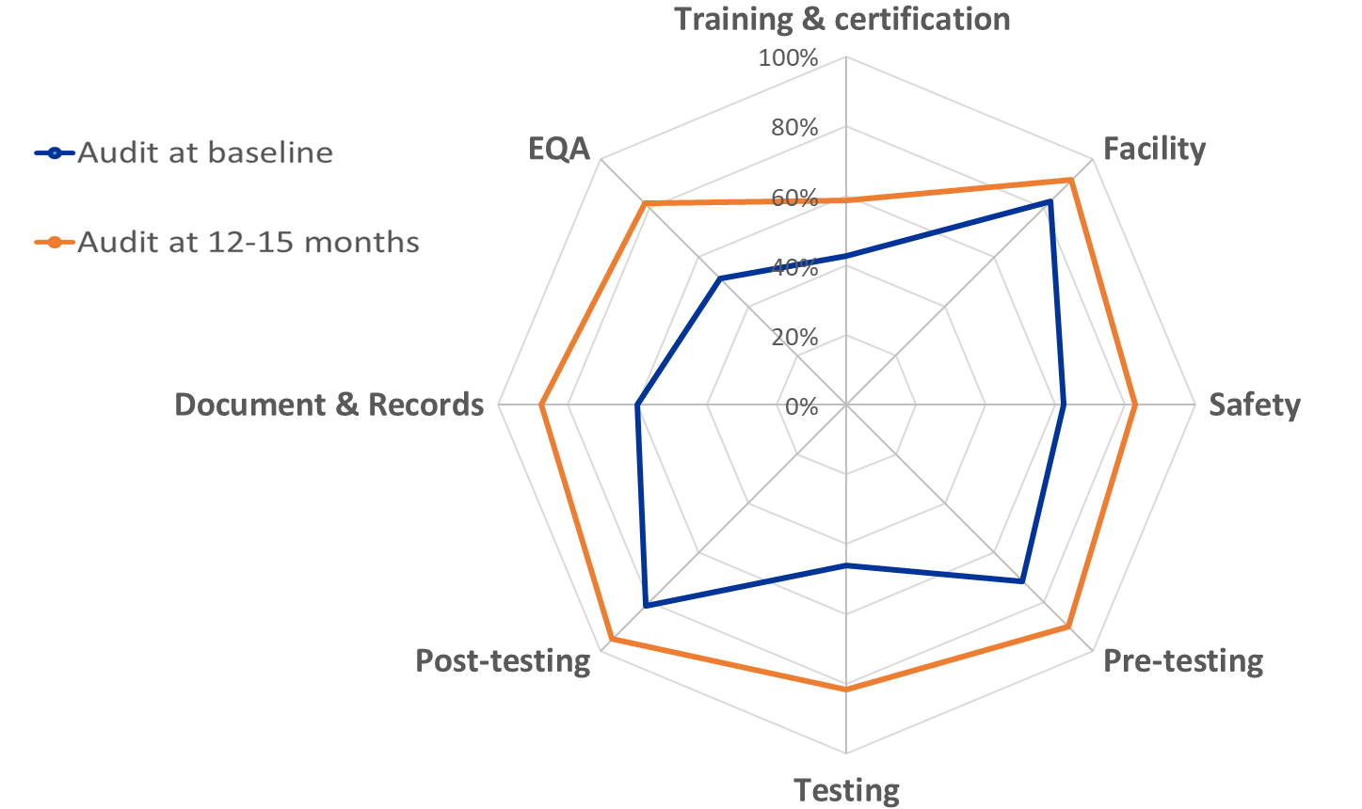
Site Audit Data from Baseline to Last Audit (N = 830)

Slide 15
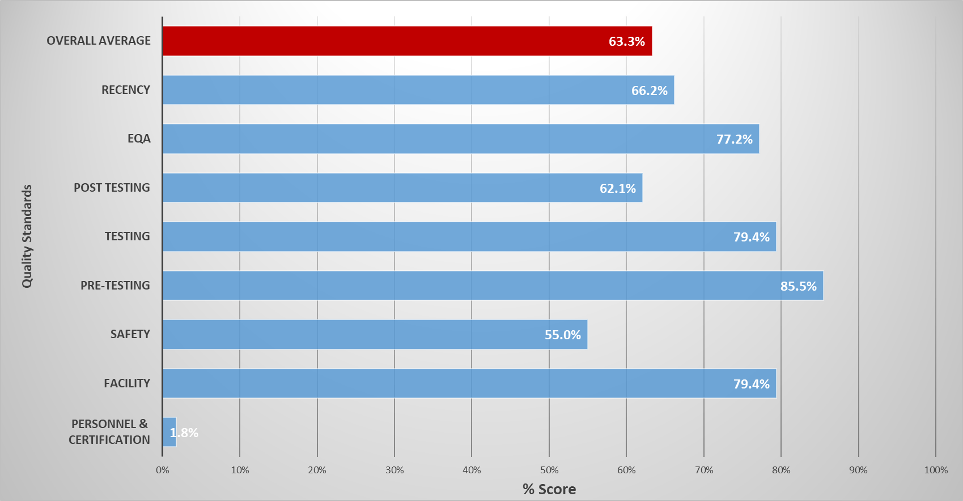
Mean Performance of Quality Standards Across 17 Testing Points -Country Y
Notes:
The figure above shows the eight quality standards, which includes recency, that were assessed at each testing point. Documentation (post-testing) and safety are two of the areas where gaps were identified. Personnel training and certification is the quality standard with the lowest score because the testers did not have any documentation of training and there is no program in place to certify testers. Although there are challenges at sites, the sites do have some quality assurance measures in place such as testing job aides, national guidelines, stock management system and understanding of test procedures and a strong PT program.

Slide 16
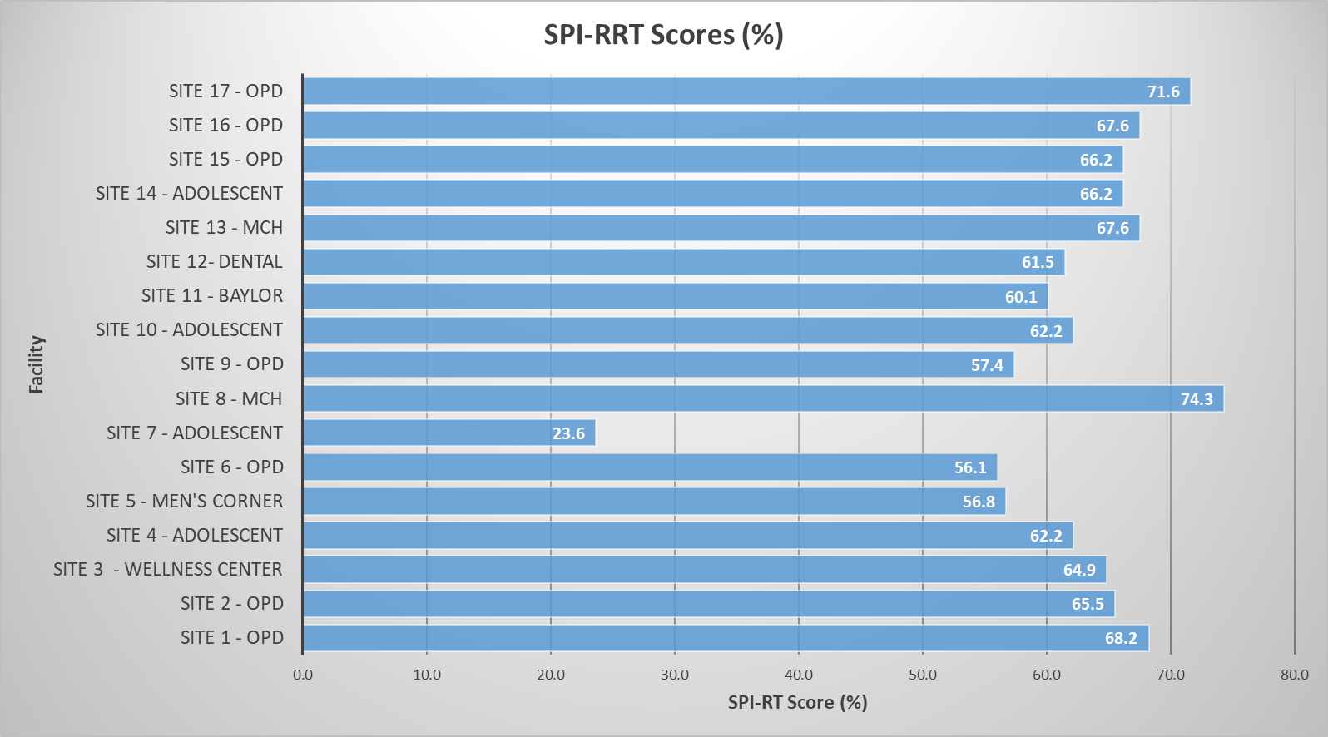
SPI-RRT Scores for 17 Testing Points – Country Y
Notes:
The figure above shows the assessment scores for each testing point. Site like Site 17 and the Site 8 have strong management systems in place. However, Site 7 needs immediate remediation since the testing point is not set-up to do HTS or Recency testing and the tester does not fully understand HTS test procedures or the recency protocol.

Slide 17
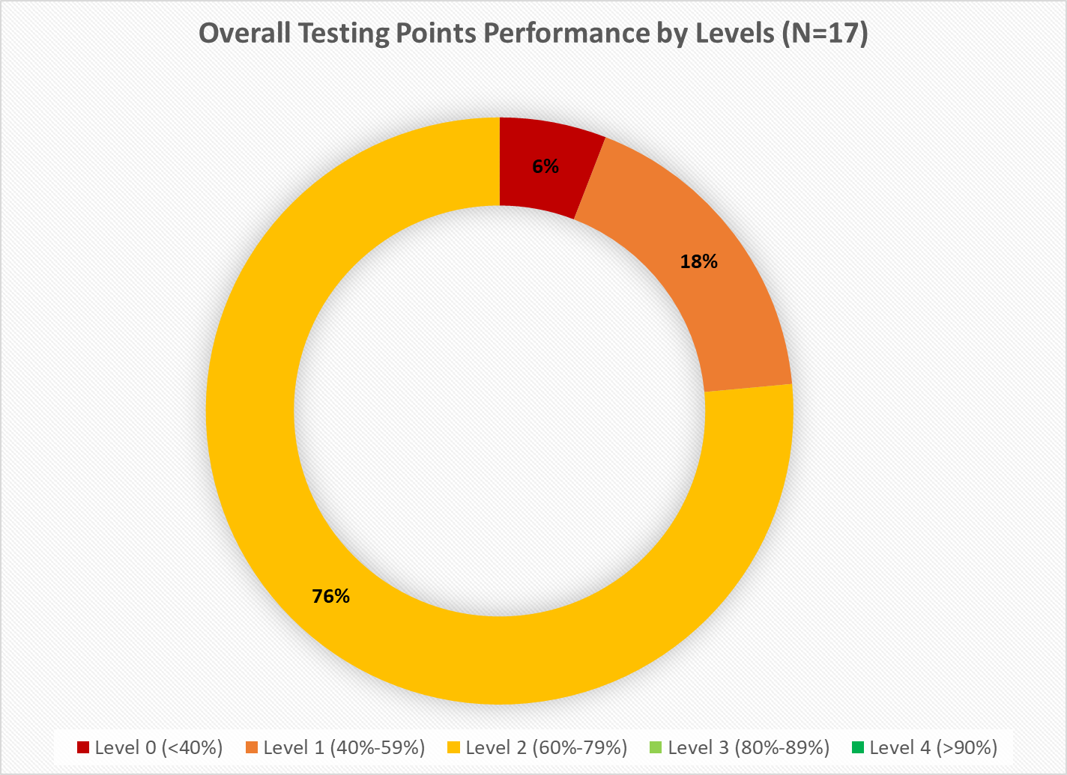
Overall Testing Point Performance by Levels (N=17) – Country Y
Notes:
The figure above shows the percentage of sites that are at level 0 (n=1), level 1 (n=3) and level 2 (n=13).

